Slide 1
ECLI in Estonia ECLI and Beyond – Improving access to court decisions 08 June 2017 Jaanika Jundas

Slide 2
Technical solution
Court IS triggers ECLI number
E-File generates the ECLI number
Public E-File keeps data for public applications
State Gazette shows it to public
Public E-File for ECLI serves data for e-justice portal
Trigger
Generating
Public
State Gazette
E-justice
Trigger
Generating
Public
State Gazette
E-justice
Trigger
Generating
Public
State Gazette
E-justice

Slide 3
ECLI number
ECLI:EE:HMK:2017:2.15.114509.7291
ECLI:EE:VMK:2017:1.16.5702.7521
ECLI:EE:VMK:2017:1.16.5702.6647
ECLI number is unique for one decision
ECLI number includes original court case number
All decisions get ECLI (not only final decision)
Decision may change (persons' names)
Decisions can be withdrawn

Slide 4
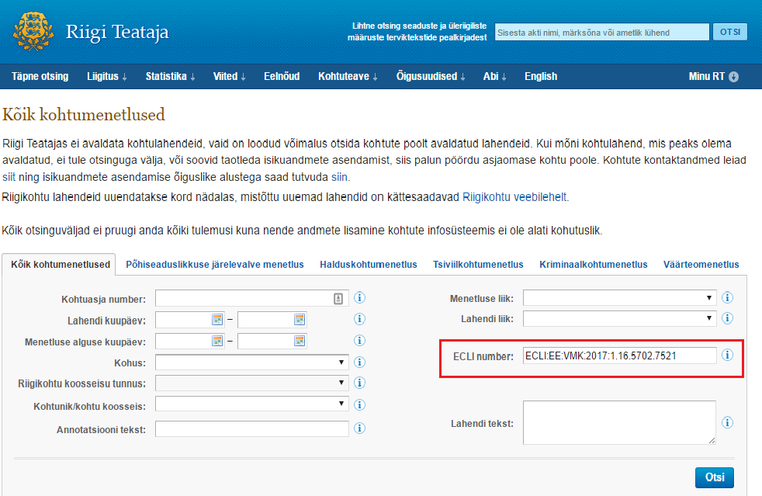
ECLI search in State Gazette

Slide 5
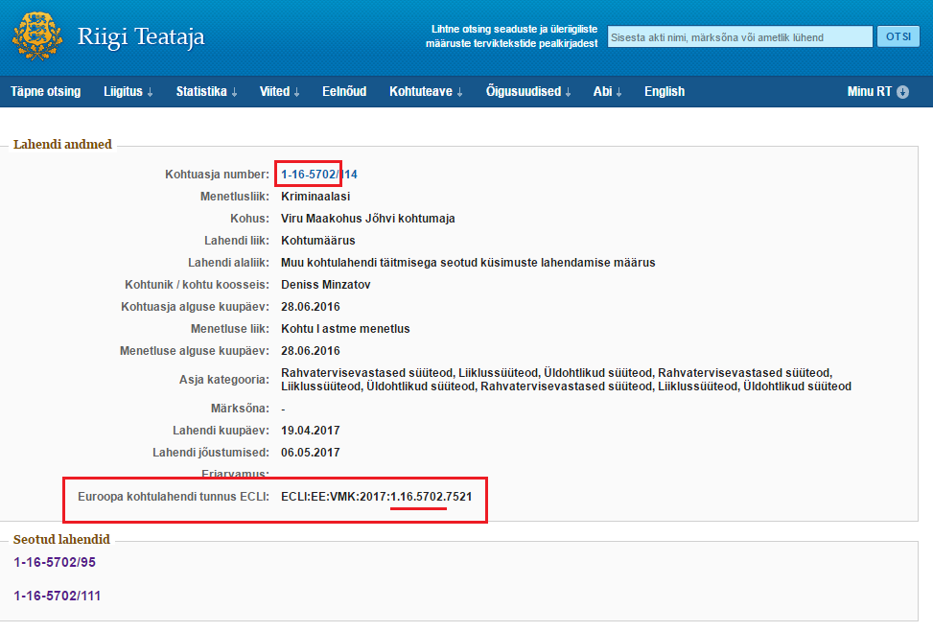
ECLI search in State Gazette

Slide 6
Challenges
Technical
Related applications
Where to generate the ECLI number?
New developer for State Gazette
Change of state infrastructure (x-road)
Lack of human resources
Juridical
Changeable decisions

Slide 7
Dates and Statistics
Since 25 May 2017
ECLI numbers are visible in State Gazette
Supreme Court
All decisions
Total 10975
County, Administrative and Circuit Courts
Court decisions made from October 2016
County Courts 15 984
Administrative 1703
Circuit Courts 3406

Slide 8
Positive things to remember
Nice project with definite purpose
Technical documentation for e-Justice
Interesting for developer (interfacing with e-Justice portal)
Administrative support

Slide 9
Questions? Thank you!
Jaanika Jundas
Jaanika.Jundas@just.ee
+372 663 6328
This presentation has been produced with the financial support of the Justice Programme of the European Union. The contents of this publication are the sole responsibility of the partners of the BO-ECLI project and can in no way be taken to reflect the views of the European Commission.
This project is co-funded by
the European Union

